Slide 1


Earthquake Preparedness
for Everyone, with Everyone
Pacific ADA Center Webinar
January 09, 2020

Slide 2


Presenters
Mark Benthien
Dir. for Communication, Education,
and Outreach
Southern California Earthquake Center
Executive Director
Earthquake Country Alliance
benthien@usc.edu
213-740-0323
Shannon M. Mulhall
Seniors and People With Disabilities
Committee Chair
Earthquake Country Alliance
Certified ADA Coordinator,
City of Fresno
Shannon.Mulhall@fresno.gov
559-621-8716
EarthquakeCountry.org

Slide 3
What We Will Cover Today
Available educational tools and resources for earthquake preparedness outreach, exercises, and drills
How to modify earthquake preparedness and safety steps for people with Disabilities or other Access and Functional Needs
A best practice model for Train-The-Trainer earthquake trainings

Slide 4
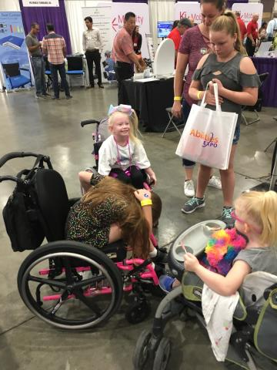
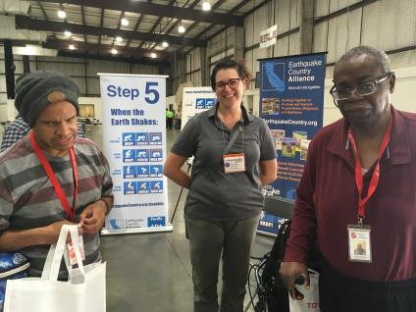
Whole Community

Slide 5
From Partnerships to Relationships
Emergency Managers: Do you know your community?
Community Members: Do you know your emergency managers and first responders?
Build relationships long before the disaster.

Slide 6
Have you considered…
What if power, gas, and phone lines are not working?
What can you do independently?
With what do you need assistance?
Will regular sources of assistance be available?
What if roads and sidewalks are impassible?
What if transportation is unavailable?
How will you maintain supplies of water, food, medications, and other needs?

Slide 7
Who? You!
YOU are the most qualified person to prepare yourself for disasters
You know your disability and needs

Slide 8
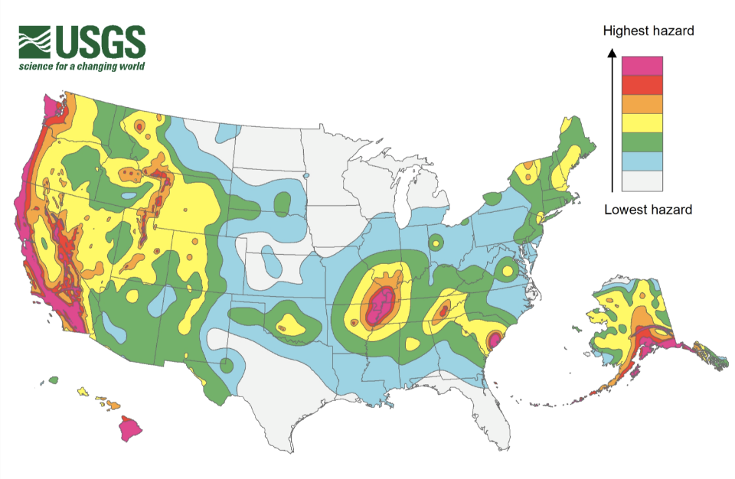
Most States Have Earthquakes

Slide 9
“But We Don’t Have Earthquakes…”
Everyone, Everywhere should know how to protect themselves during earthquakes
Damaging earthquakes can happen at any time in most states of the Central U.S. and Southeast
People may travel to earthquake prone areas and experience a major earthquake

Slide 10
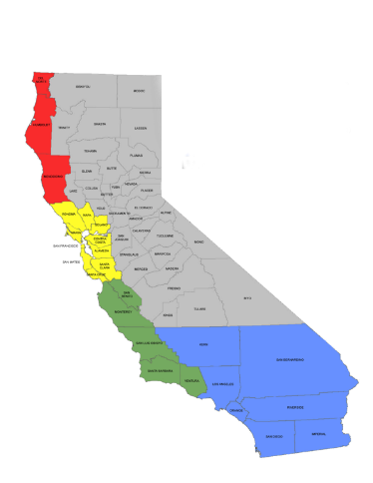

Earthquake Country Alliance
California partnership of people, organizations, and regional alliances
Regional alliances plan activities and coordinate partnerships
Statewide committees identify sector-based needs and develop resources
Funded by FEMA and CalOES
www.EarthquakeCountry.org
Redwood Coast
Tsunami Workgroup
Bay Area
Earthquake Alliance
Future Alliance
Earthquake Country
Alliance, So Cal

Slide 11
ECA Committees & Bureaus
Businesses
Seniors and People with Disabilities
EPIcenters (museums, parks, libraries, etc.)
Healthcare
Non-Profits and Faith-Based Organizations
Public Sector (Government EM & Elected Officials)
Schools (K-12)
Schools (Higher Ed)
Multicultural
Media Bureau
Events Bureau
Participation Bureau

Slide 12
S/PWD Objectives
ECA Seniors and People With Disabilities Committee works to:
Engage Seniors/People With Disabilities and others with Access & Functional Needs to practice alternatives to “Drop Cover and Hold On”
Provide meaningful resources for the whole community
Increase the number of Seniors and People With Disabilities included in preparedness and outreach activities
  Register individuals/groups in ShakeOut drills to quantify participation
  Identify gaps in preparedness efforts

Slide 13
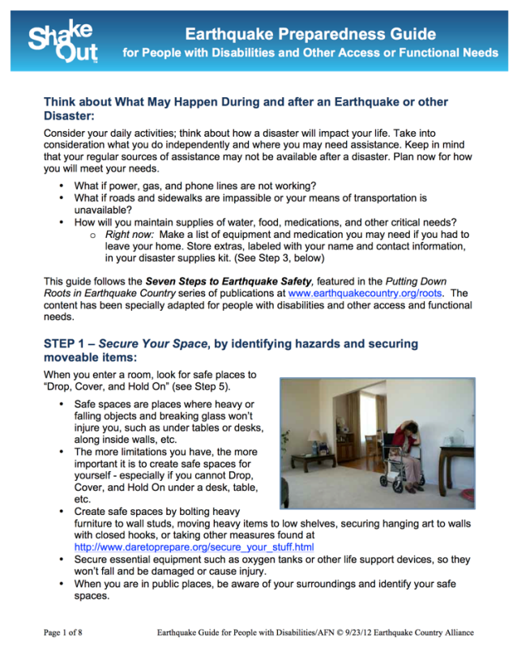
Seniors and People With Disabilities Resources
Earthquake Preparedness
Guide for People with
Disabilities and Other
Access or Functional
Needs
Organized according to
Seven Steps to Earthquake
Safety
Also simple “Tips” document
earthquakecountry.org/disability

Slide 14
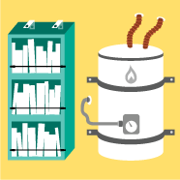






Seven Steps To Earthquake Safety
BEFORE
1. Secure
Your Space
2. Plan
To Be Safe
3. Organize
Supplies
4. Minimize
Financial
Hardship
DURING
5. Drop, Cover,
and Hold On
6. Improve
Safety
7. Reconnect
and Restore
AFTER
EarthquakeCountry.org/sevensteps

Slide 15
Step 1: Secure Your Space
Identify hazards
Secure moveable items
Reduce Injuries and damage
EarthquakeCountry.org/step1

Slide 16
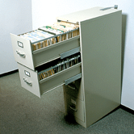
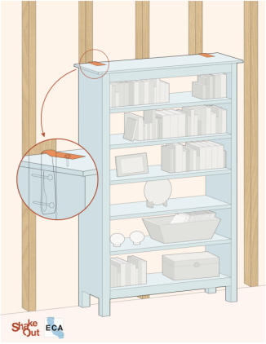
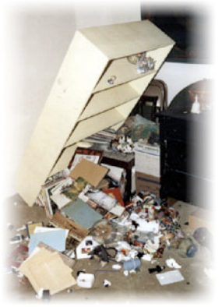
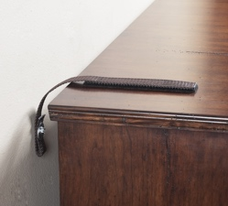
Top-Heavy Furniture
Use flexible nylon straps (buckles or velcro)

Slide 17
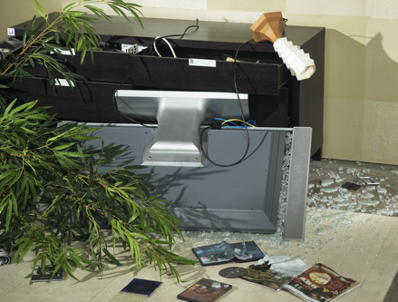
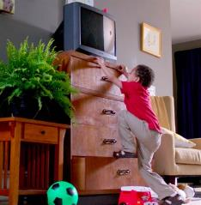
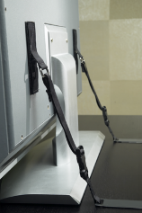
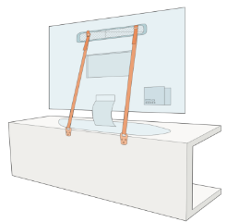
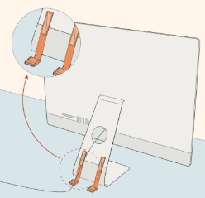
TVs and Electronics
Straps and buckles secured with adhesive and bolted to anchor points
Notes:
Falling TVs send a child to the ER every 30 minutes.

Slide 18
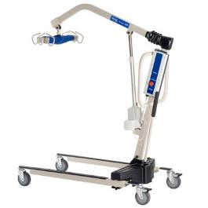
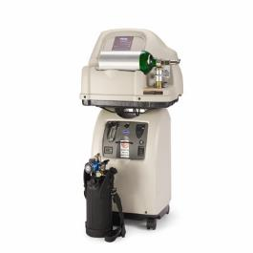
Essential Equipment
Oxygen tanks
Life support devices
Lifts/hoists (placement)
Notes:
Secure essential equipment such as oxygen tanks or other life support devices
Consider placement of lifts/hoists when not in use – may not be able to strap them down but can store to minimize issues

Slide 19
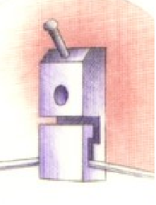
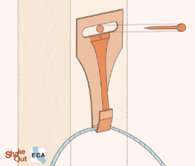

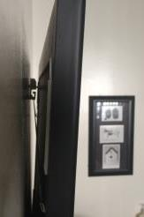
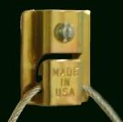

Wall Hangings
No glass above beds
Use closed hooks

Slide 20
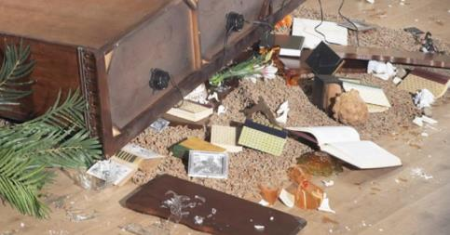
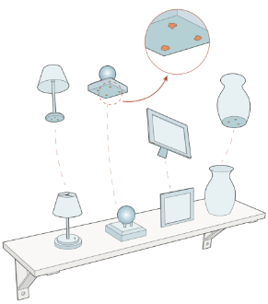


Smaller Items
Earthquake Putty
Microcrystalline Museum Wax

Slide 21
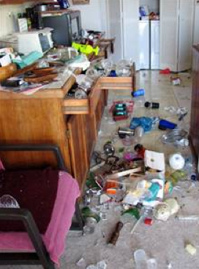
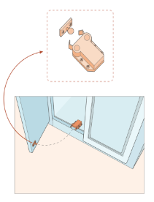
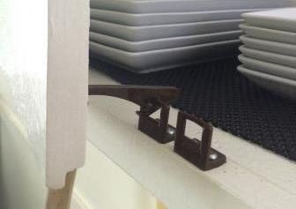
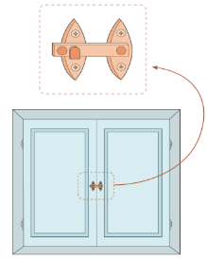
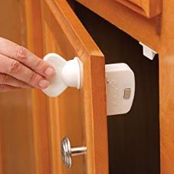
Kitchen Cabinets
Many options available at hardware stores and online
Notes:
Challenge: finding one for limited dexterity. Look toward magnetic varieties

Slide 22
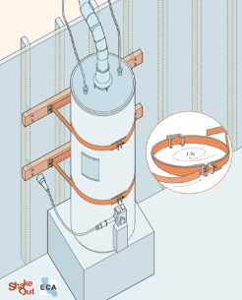
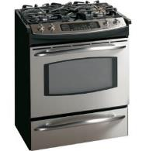
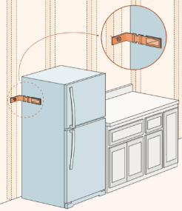
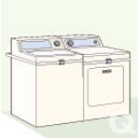
Water Heaters and Large Appliances
Use flexible stainless-steel gas connectors
Secure large appliances to wall studs

Slide 23
Begin to Secure Your Space:
TODAY:
Move a heavy object to a lower location
Review EarthquakeCountry.org/step1
List potential hazards to be secured
List what to buy (online or at hardware stores)
Secure everything in a weekend, or over time
Show your friends, family, neighbors (even better… help each other!)

Slide 24
Step 2: Plan to Be Safe
Create a disaster plan
Decide how to communicate in an emergency
EarthquakeCountry.org/step2

Slide 25
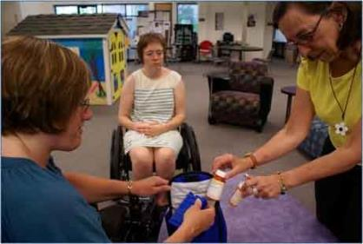
Personal Support Team (PST)
At least 3 people
Home, work, recreation
Know your unique needs and plan
Able to assist after earthquake

Slide 26
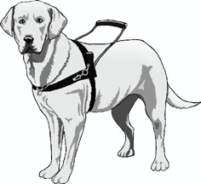
AFN Planning for Individual Needs:
Label adaptive equipment
Transportation plan
Care plan for service animals

Slide 27
Step 3: Organize Disaster Supplies
At home, work, and in your car
Copies of prescriptions, extra glasses, etc.
Essentials for 3 days, ideally 2 weeks
EarthquakeCountry.org/step3

Slide 28
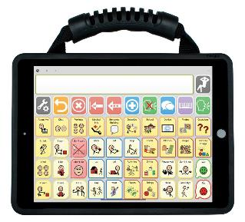
DAFN Considerations
Medications (prescription, over-the-counter medications)
Medical supplies
Medical/Health information
Medication list
Copy of prescriptions
Communication supplies

Slide 29
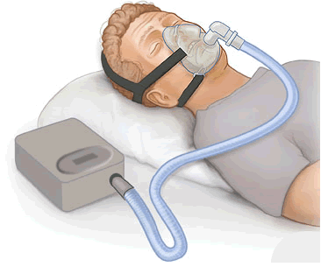
Supplies for Specific Needs:
Hearing aid batteries
Eye glasses
Walking stick
Oxygen or nebulizer supplies
Blood glucose tester
Hygiene Equipment
Catheter supplies
Feeding equipment
Hygiene Supplies
Soothers/calmers

Slide 30
Service Animal Supplies
License and ID tags
copies of service animal documentation
Immunization records, medications, and veterinarian’s contact information
extra animal food, water, and bowls
Extra harness and/or leash
Booties (practice using them!)

Slide 31
Step 4: Minimize Financial Hardship
Organize important documents
Strengthen your property
Consider insurance
EarthquakeCountry.org/step4

Slide 32
Additional AFN Considerations
Health care power of attorney
Advance directives
Social security documentation

Slide 33
Step 5: Drop/Lock, Cover and Hold On
When the earth shakes, act immediately
Protect yourself from falling to the ground, or from falling objectys
EarthquakeCountry.org/step5

Slide 34
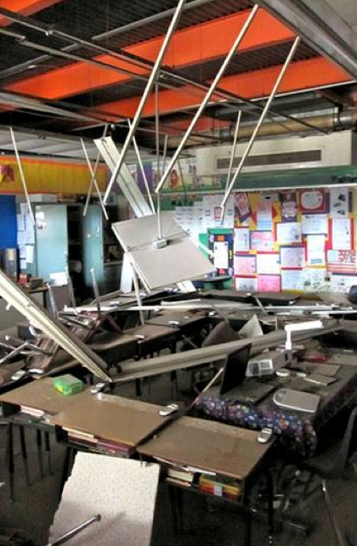
Why Drop/Lock, Cover, and Hold On?
Prevents being thrown to the ground
Reduces injury from falling or flying items
Increases chance of surviving collapse
Classroom in Calexico, CA
April 2010, M7.2
EarthquakeCountry.org/step5

Slide 35
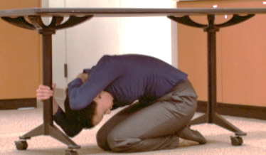
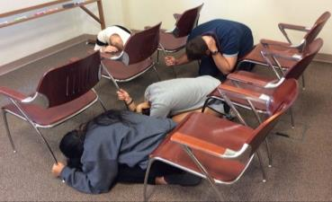
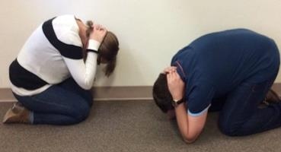
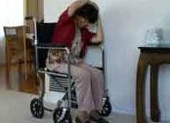
Drop
If possible:
Drop on to your hands and knees, where you are
EarthquakeCountry.org/step5 has advice for a variety of settings

Slide 36
Cover
Cover your head and neck
with one arm and hand.
If a sturdy table or desk is nearby, crawl underneath it for shelter
If no table/desk, crawl against a wall or next to low furniture for sideways protection
EarthquakeCountry.org/step5 has advice for a variety of settings

Slide 37
Hold On
Hold On to your shelter until shaking stops
Be ready to move with your shelter
If not under a shelter, hold on to your
head/neck with both arms and hands
EarthquakeCountry.org/step5 has advice for a variety of settings

Slide 38
Adapt Your Response
If you can’t get back up, don’t get down
  Bend over and cover your head and neck with your arms/hands
  If you can’t cover head and neck, cover torso
Instruct others how to assist you
Practice is key
Notes:
EarthquakeCountry.org/disability

Slide 39

Using a Cane

Slide 40

Using a Walker/Rollator

Slide 41
Using a Wheelchair

Slide 42
Earthquake Safety Video Series
Separate short videos:
People with mobility disabilities
Indoors, nearby table/desk
Indoors, no table/desk
theater/stadium
Near the shore
In a car
In bed
View at
Youtube.com/greatshakeout
Download at
www.ShakeOut.org/messaging

Slide 43
Step 6: Improve Safety
Connect with PST
Evacuate if necessary
Help the injured
Prevent further injuries or damage
EarthquakeCountry.org/step6

Slide 44
Service Dog Considerations
Service animal may be frightened or injured
May not be able to work immediately
Increased risk of injury to paws from broken glass or debris on the ground
Be prepared to use alternate equipment if your animal cannot provide its normal services.

Slide 45
Step 7: Reconnect and Restore
Restore daily life
Reconnect with others
Repair damage
Rebuild community
EarthquakeCountry.org/step7

Slide 46
Review Plan with PST
Did the plan work?
What needs to change for next time?
What was forgotten?

Slide 47

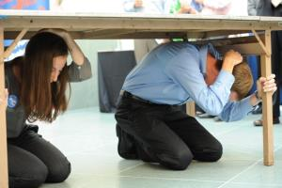
Great ShakeOut Earthquake Drills
Schools, organizations, and families practice earthquake safety and other aspects of their emergency plans
2019: 66+ million people worldwide;
10.9 million in California
2020 International ShakeOut Day:
October 15
Learn more and register:
ShakeOut.org

Slide 48
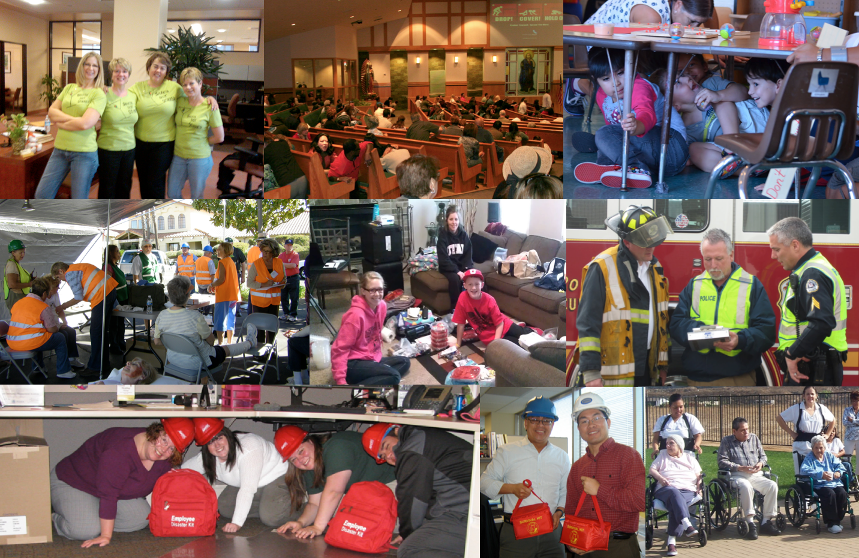
Everyone can ShakeOut!

Slide 49
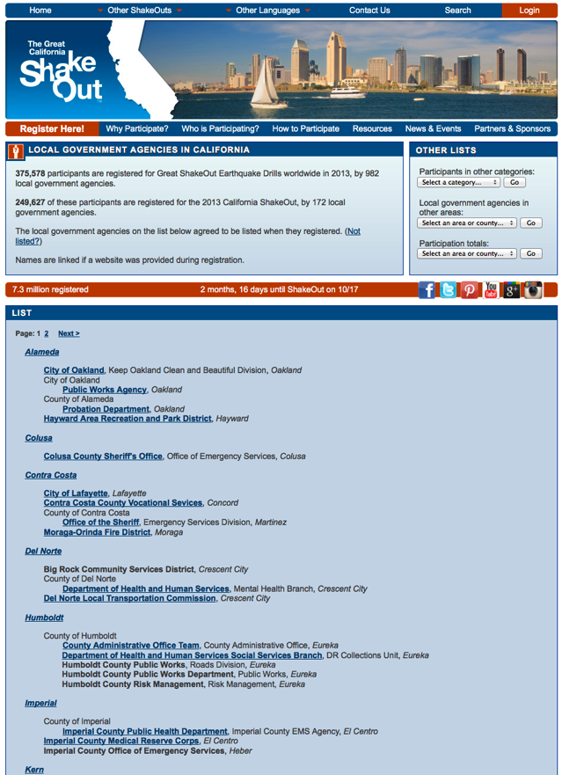
Benefits of Registering
Be:
Counted in the world’s largest earthquake drill
Updated with news and safety tips
Listed with other participants
An example that motivates others
Better prepared to survive
Have peace of mind that you have taken action and helped others

Slide 50
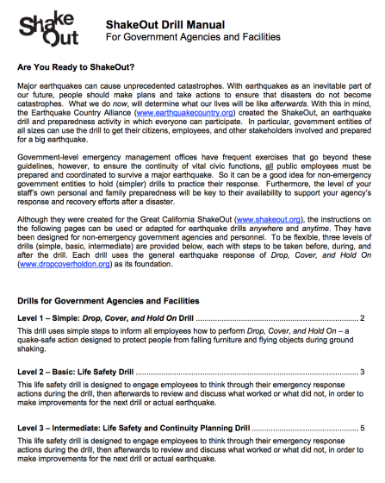
ShakeOut Drill Manuals
Level 1:
Drop, Cover, Hold On drill
Level 2:
Drop, Cover, Hold On, then evacuation, search/rescue
Level 3:
Adds Continuity Planning

Slide 51
Develop Working Groups
Get involved on planning committees – or create your own
Know each other by name before incident
Questions:
What do responders need to know about the population you represent?
What assets does your organization bring to the table?
What tools should responders know about to assist the population you represent?

Slide 52
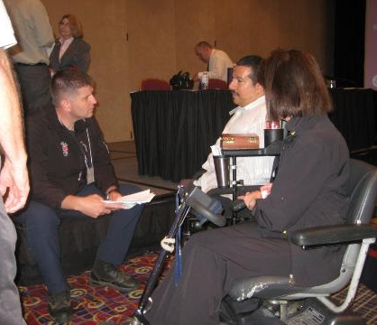
Building Relationships through Drills
Invite/offer to participate in local drills
Use the existing resource manuals
Notes:
Richard Devylder

Slide 53
Accessible ShakeOut Events
Select accessible locations
  Parking
  Event room
  Restroom
  Access to Public Transportation
Contact info for interpreter or captioning requests
Provide non-verbal information and large print materials

Slide 54

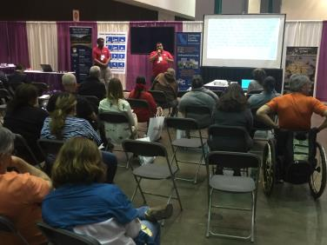
ECA at Abilities Expo
ECA hosts preparedness booths and workshops each year in LA and the Bay Area
Representatives from CalOES, FEMA American Red Cross, local governments, and other partners
www.Abilities.com

Slide 55

Promising Practice: PrepItForward
ToolBoxes
T-T-T Academy
https://prepitforward.com/

Slide 56
Great ShakeOut Course Overview
Topics:
Meeting Everyone's Needs - DAFN
Earthquake Awareness & Preparedness
Drop/Lock, Cover &
Hold On
ShakeOut Resources
ShakeOut Drill
This training provides basic knowledge and information needed to be prepared for, respond to, and recover from an earthquake at home, school, in the workplace and anywhere they find themselves during an earthquake.
Attendees also participate in an earthquake drill and debrief.

Slide 57

ToolBox Resources
Course Presentation
Trainer Guide
Student Guide
Attendee Sign-In Sheet
Pre/Post Surveys
DAFN Disaster & Emergency Communication Guide
Earthquake Preparedness Guide for People with Disabilities and Other Access or Functional Needs
Key Earthquake Safety Tips for People with Disabilities and Other Access or Functional Needs
Recommended Earthquake Safety Actions

Slide 58
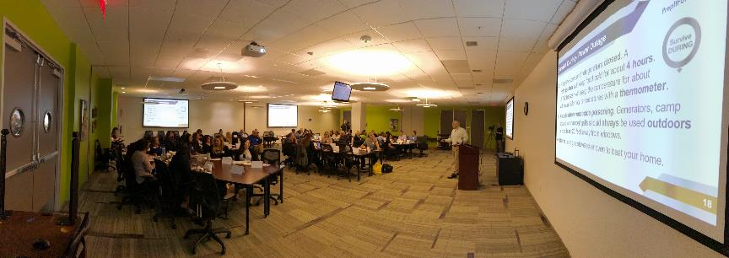
Train the Trainer Academy
The (3) day Train-the-Trainer Academy prepares trainers to effectively and efficiently utilize the DAFN ToolBoxes to facilitate standardized disability and access and functional needs inclusive disaster and emergency preparedness training and drills throughout an organization.
Learn more: prepitforward.com

Slide 59
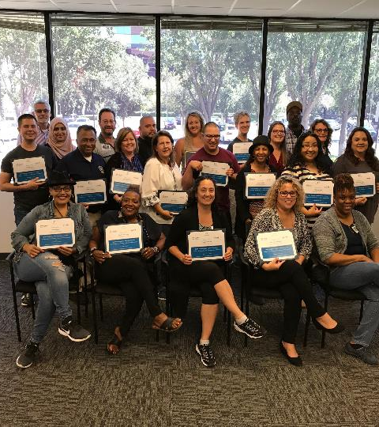
Access to ToolBoxes
Upon completion of the T-T-T
Academy, you are certified to
facilitate the Great ShakeOut training.
Visit prepitforward.com to access the toolboxes via your desktop or mobile device.

Slide 60
Resources & Registration
  www.earthquakecountry.org/disability
  Earthquake Preparedness Guide for People with Disabilities and Other Access or Functional Needs
  (8 pages)
  Key Earthquake Safety Tips for People with Disabilities and Other Access or Functional Needs
  (2 pages)
  www.ShakeOut.org/register
  Register as a “Disability/AFN” organization
  Or for any category, indicate the number of seniors or people with disabilities when you complete the registration form.

Slide 61
Connect with ECA & ShakeOut
213-740-3262
info@earthquakecountry.org
info@shakeout.org
Twitter.com/eca
Twitter.com/shakeout #ShakeOut
Facebook.com/greatshakeout

